Slide 1
Oriental Bittersweet Cacapon State Park
November 2019

Slide 2
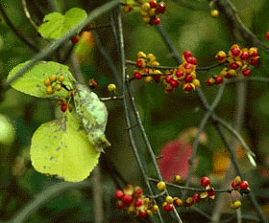
Oriental bittersweet (Celastrus orbiculatus)
Notes:
https://mnfi.anr.msu.edu/invasive-species/OrientalBittersweetBCP.pdf
Oriental bittersweet is an invasive, non-native vine that is native to China, Japan and Korea. It was introduced into the United States around 1860 as an ornamental plant. Its fruiting stems are cut in fall and used for decoration, which
unfortunately facilitates its spread. Oriental bittersweet is a deciduous, woody, twining vine that may reach 98.5’ in length and 7” in diameter. It climbs by coiling around trees, shrubs and any other available support. It has a deep, extensive root system.

Slide 3
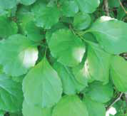
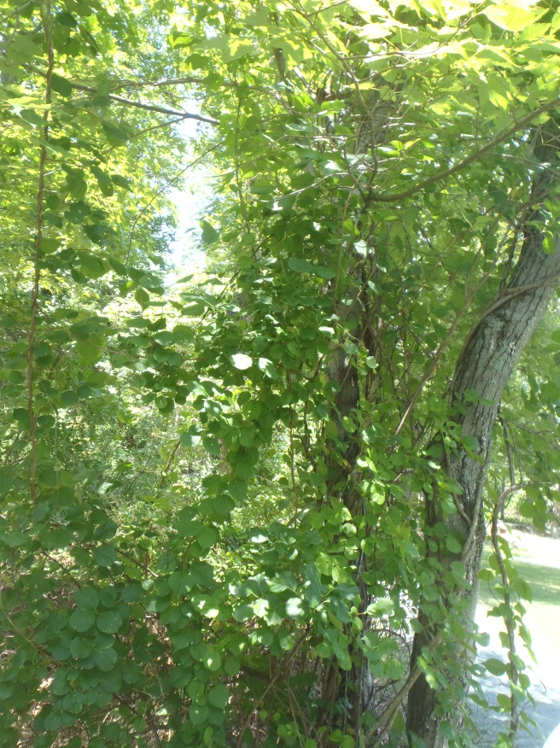
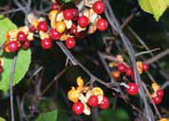
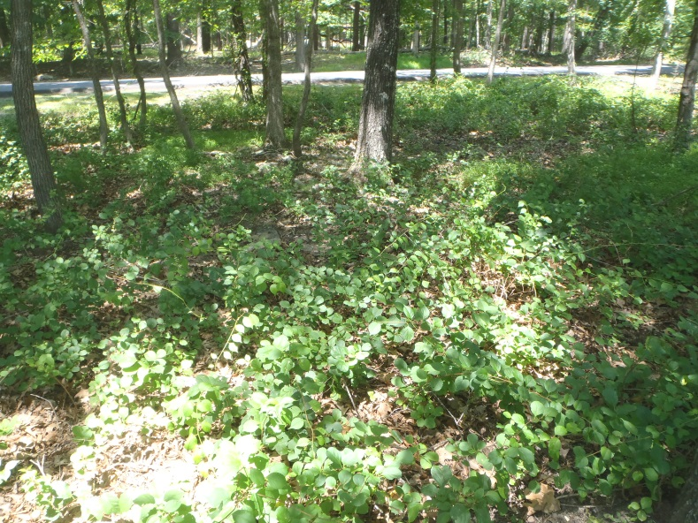
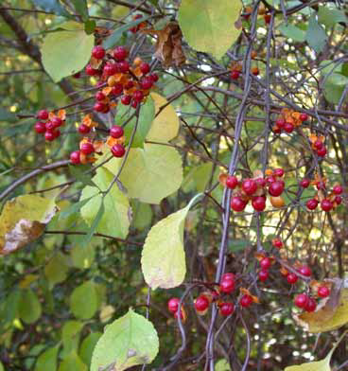
Flowers: greenish yellow
5-petalled
Leaves: broad alternate
fine-toothed glossy
less than 2X as long as wide
Fruit: outer skin scarlet
clustered on leaf axils
2 or 3 fruits per cluster
Grows in a vine up trees
Fruits: red found in the axils of leaves all along the stems
Grows on the ground
Notes:
https://mnfi.anr.msu.edu/invasive-species/OrientalBittersweetBCP.pdf
Leaves: Oriental bittersweet’s leaves are alternate, glossy and finely toothed. They are often rounded but are variable in shape. They range from 2-5” long and have pointed tips. They turn yellow in fall, and retain their leaves late in the season.
Bark/Stems: Bittersweet’s stems are light or medium brown, with white
pith. They often have noticeable light horizontal marks.
Stems may climb up to 60’ high in trees. Roots are a bright orange.
Flowers: Oriental bittersweet has small, greenish yellow, five-petaled
flowers that are clustered in the leaf axils. Male and female
flowers usually occur on separate plants and sometimes
Male flowers are at the tip of the branch. They bloom in May and June.
Fruits/Seeds: Bittersweet has conspicuous bright fruits. The yellowish orange
outer skin covers a fleshy scarlet aril, with 3 to 6 seeds. The fruits are clustered
in leaf axils of female plants and persist through winter.
Habitat: Oriental bittersweet occurs in grasslands, open woods, woodland edges, closed-canopy forest, roadsides and fence rows. Although it is most productive in full sun, its seedlings are extremely shade-tolerant.

Slide 4
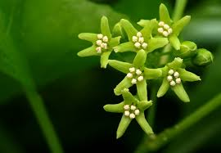
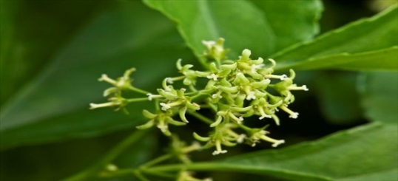
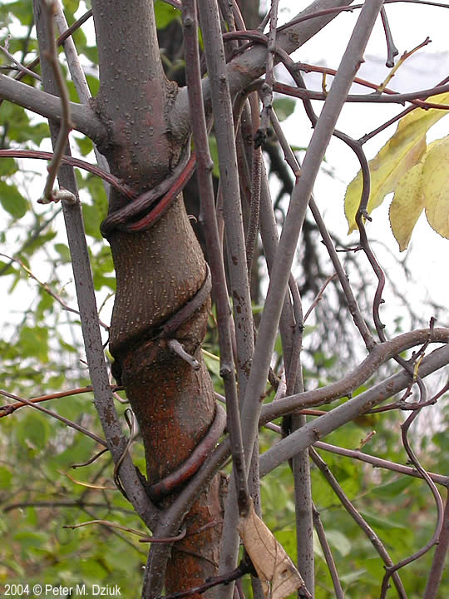
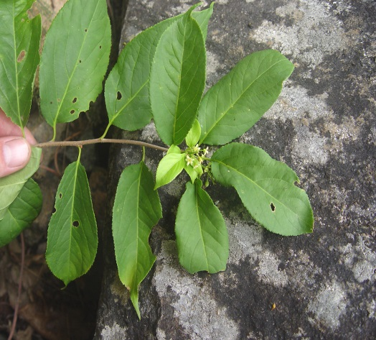
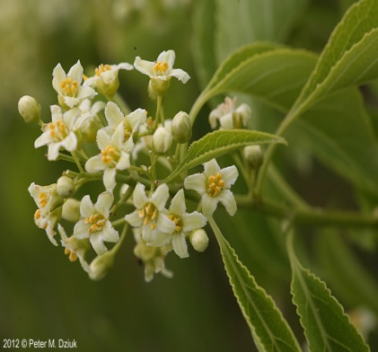
Invasive: Oriental bittersweet (Celastrus orbiculatus)
Flowers: male greenish 5-petaled
Leaves: alternate glossy
finely-toothed
Stem: with white marks
Native Look Alike:
American bittersweet (C. scandens)
Flowers: female 5-petaled
greenish yellow
Flowers: in a panicle
5-petaled white
Stem: dark brown
Leaves: wavy margins
Notes:
https://gobotany.newenglandwild.org/species/celastrus/orbiculatus
https://commons.wikimedia.org/wiki/File:Oriental_bittersweet
https://www.dnr.state.mn.us/invasives/terrestrialplants/woody/oriental_bittersweet.html
American bittersweet has orange capsules around red fruits, Oriental bittersweet has yellow capsules around red fruits.
American bittersweet flowers and fruits are only found at the terminal ends of stems, Oriental bittersweet flowers and fruits are found all along the stem at leaf axils.
Leaf shape is highly variable and not a good characteristic for distinguishing American vs. Oriental bittersweet.
https://mnfi.anr.msu.edu/invasive-species/OrientalBittersweetBCP.pdf
Max Williamson USDA FS Bugwood.org https://mnfi.anr.msu.edu/invasive-species/OrientalBittersweetBCP.pdf

Slide 5
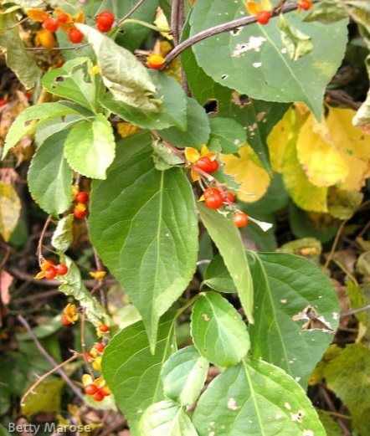
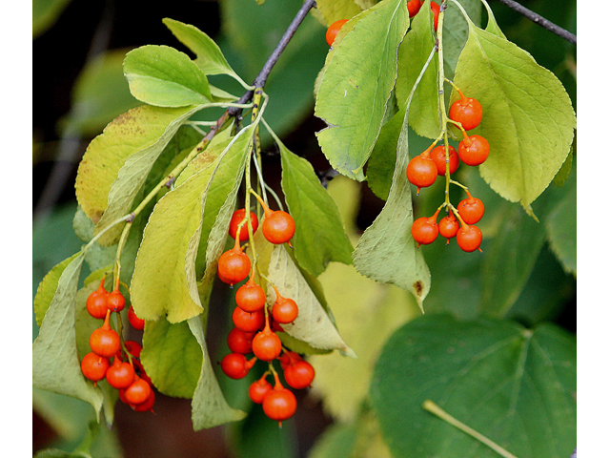
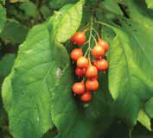
Invasive: Oriental bittersweet (Celastrus orbiculatus)
Fruit: 2-3 in axils of leaves
Native Look Alike: American bittersweet (C. scandens)
Fruit: 6 or more in cluster at end of stem

Slide 6
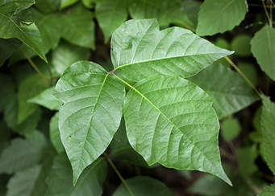
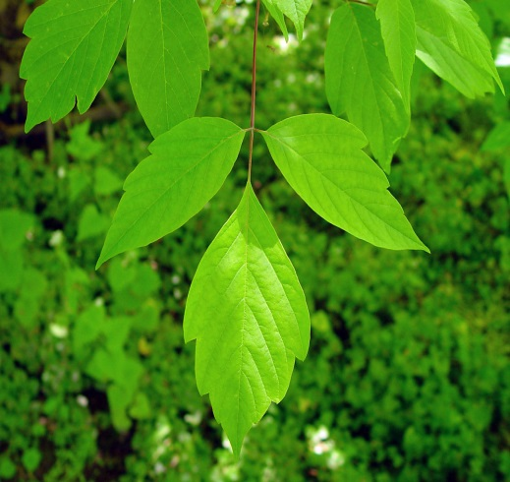
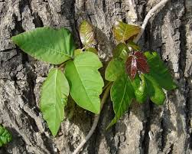
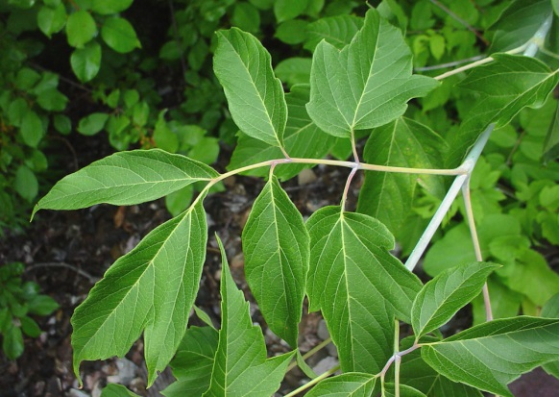
Oriental bittersweet (Celastrus orbiculatus)
Invasive:
Native Look Alikes:
Poison ivy
(Toxicodendron
radicans)
Box elder
(Acer negundo)
Leaves: alternate glossy
finely-toothed
Leaves: pointy
Leaves: toothed
Grows: vertical up a tree
Grows: large to become a tree
Notes:
http://www.ediblewildfood.com/kudzu.aspx
https://ask.metafilter.com/268072/How-do-you-tell-the-difference-between-poison-ivy-and-kudzu Insider.si.edu
Kudzu and poison ivy share similar characteristics
Both have leaflets that come in three (trifoliate), with the top leaflet having a much longer stem and leaflet veins are alternate. Some differences in leaflet shape -- kudzu is a little more lobe-shaped and less pointy than poison ivy.
Poison ivy isn't a vine (though it sometimes grows up trees). Poison ivy tends to be more of an "underbrush" or ground cover. Shoots growing vertically up in the air from the ground, more likely poison ivy. Kudzu vines outwards in all directions, and doesn’t send shoots up towards the sky. Poison ivy can turn into a bush if gets out of control. Poison ivy is more common in areas that are frequently mowed/cleared, along paths and in clearings, and at poorly maintained campsites. The roundness vs. pointiness of the lobes is the best thing to go by.
If the overall leaf pattern is mostly round, lobed leaves it's kudzu, and if most of the leaves have pointy lobes it's poison ivy. Also kudzu leaves are larger than poison ivy leaves, and the undersides are hairy. Kudzu vines send out tendrils that wrap in coils, like bean plants. Kudzu is like a bean on steroids, which makes sense because they are in the same family.
Box elder seedlings and young plants resemble poison ivy but grows into a tree and leaves more serrated https://www.google.com/imgres?imgurl=https://newfs.s3.amazonaws.com/taxon-images-1000s1000/Sapindaceae/acer-negundo-violaceum-le-gmittelhauser.jpg&imgrefurl=https://gobotany.newenglandwild.org/species/acer/negundo/&h=750&w=1000&tbnid=joe0d2_SpezxzM:&q=box+elder+tree&tbnh=150&tbnw=200&usg=AI4_-kRtyENtHlUNhufqisHayxRqi-4efg&vet=12ahUKEwjlw5fY-73eAhXk34MKHSfiA9AQ_B0wHnoECAEQBg..i&docid=VV5aHawczxhtRM&itg=1&sa=X&ved=2ahUKEwjlw5fY-73eAhXk34MKHSfiA9AQ_B0wHnoECAEQBg

Slide 7
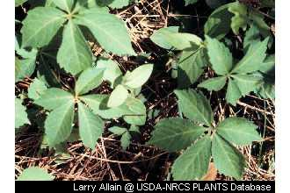
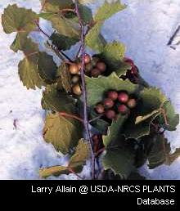
Oriental bittersweet (Celastrus orbiculatus)
Invasive:
Native Look Alikes:
Virginia creeper
(Parthenocissus quinquefolia)
Native Grape
(Vitus sp.)
Leaves: alternate glossy
finely-toothed
Leaves: scalloped and 5 lobed
Leaves: palmately lobed
or toothed on edges
Notes:
http://www.wvdnr.gov/wildlife/native_shrubs-virginiacreeper.shtm
Virginia Creeper, Woodbine- Parthenocissus quinquefolia Wild Raisin (Appalachian Tea) – Viburnum cassinoides
Form: High climbing or trailing woody vine, sometimes climbing to crowns of tall trees, 30 to 55 feet or more.
Bark: Older vines produce tendrils along stem to grip supports. Can be mistaken for poison ivy.
Leaves: Deciduous, alternate, compound, 5-leaflets, leaflets 2 to 6” long, oval to elliptical or lanceolate, coarsely toothed above middle. Purple to crimson in autumn.
Flowers: June-July. Terminal clusters or from upper leaf axils, 25 to 200 flowers per cluster, greenish-individual flowers 1/8 inch across. Not showy.
Fruits: Blue or black globose berry. Ripens in October, stays on vine into winter. Fruit stalks are red.
WV Range: Common in all counties.
Natural Habitat: Moist woods, thickets, fencerows, walls, hillsides and rocky banks.
Wildlife Use: Fruits, are very important as fall and winter food for songbirds, numerous other birds, including all game species. Also eaten by mice, chipmunks and skunks. Foliage and twigs browsed by white-tailed deer.

Slide 8
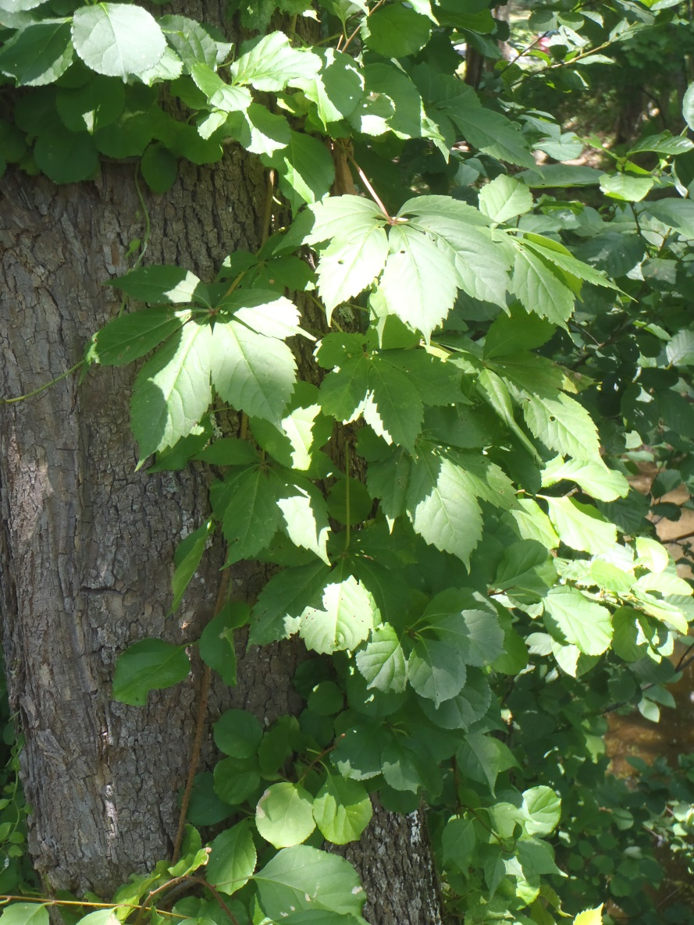
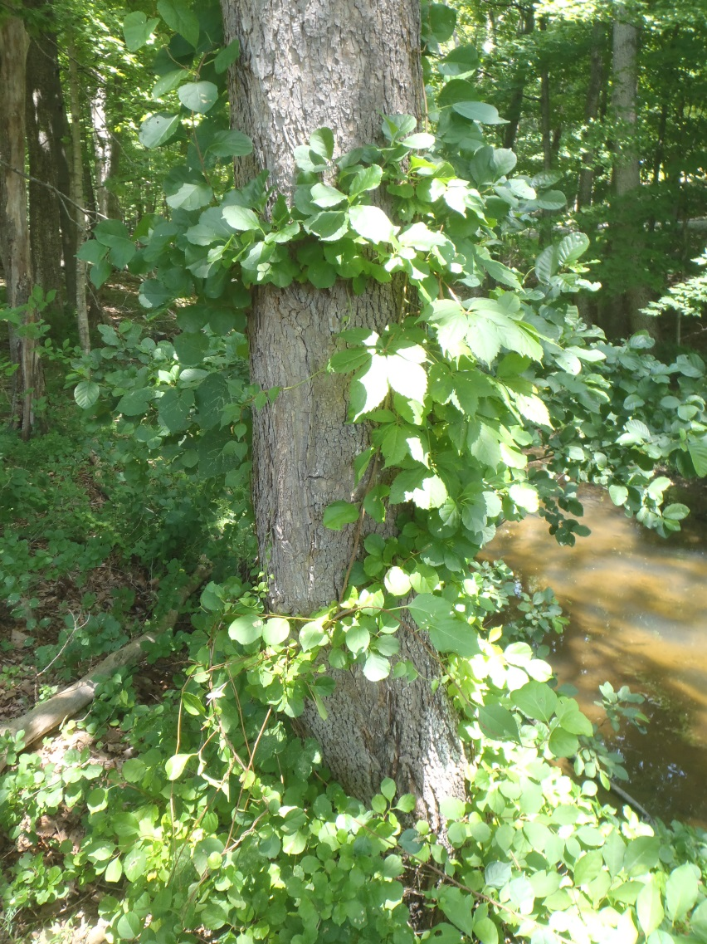
Oriental bittersweet and Virginia creeper
Notes:
http://www.wvdnr.gov/wildlife/native_shrubs-virginiacreeper.shtm
Virginia Creeper, Woodbine- Parthenocissus quinquefolia Wild Raisin (Appalachian Tea) – Viburnum cassinoides
Form: High climbing or trailing woody vine, sometimes climbing to crowns of tall trees, 30 to 55 feet or more.
Bark: Older vines produce tendrils along stem to grip supports. Can be mistaken for poison ivy.
Leaves: Deciduous, alternate, compound, 5-leaflets, leaflets 2 to 6 inches long, oval to elliptical or lanceolate, coarsely toothed above middle. Purple to crimson in autumn.
Flowers: June-July. Terminal clusters or from upper leaf axils, 25 to 200 flowers per cluster, greenish-individual flowers 1/8 inch across. Not showy.
Fruits: Blue or black globose berry. Ripens in October, stays on vine into winter. Fruit stalks are red.
WV Range: Common in all counties.
Natural Habitat: Moist woods, thickets, fencerows, walls, hillsides and rocky banks.
Wildlife Use: Fruits, are very important as fall and winter food for songbirds, numerous other birds, including all game species. Also eaten by mice, chipmunks and skunks. Foliage and twigs browsed by white-tailed deer.

Slide 9
Oriental bittersweet and grapevine
Notes:
http://www.wvdnr.gov/wildlife/native_shrubs-grapes.shtm
Fox Grape – Vitis labrusca Summer Grape – V. aestivalis Riverbank Grape – V. riparia Winter grape – V. vulpina Sand Grape – V. rupestris Muscadine – V. rotundifolia Woody vines with old shaggy bard that trail on the ground or, more often, climb trees using coiling reddish-green tendils.
Twigs and Bark: Fox & Summer-Twigs with dense reddish hairs, tendril opposite every third leaf. Pith interrupted by woody partition at each node. Riverbank & Winter- Tendrils missing from every third leaf. Pith interrupted by woody partition at each node. Sand-Tendrils none or only at uppermost nodes, pith continuous. Muscadine- Tendrils not forked, pith brown and continuous in modes. Bark smooth and dark with small dots.
Leaves: In general, are deciduous, alternate, simple and usually palmately lobed or toothed on the edge. Fox & Summer- Red woolly felt-like hairs beneath. Riverbank- Hairy below and long pointed leaf tips. Winter- Smooth and green beneath. Sand- Smooth, shiny, wider than long. Muscadine- Small and shiny green above and below.
Flowers: Green in long clusters.
Fruit: Fox- Black or purple and sweet, ½ to 1”diameter. Summer- Dark purple to black, slight white cast on fruit, ¼ to ½ inch diameter. Riverbank- Blue to black, ½ to ½” diameter. Winter- Small, black. 1/8 to ¼ inch diameter Sand- Small, black shiny and slightly flattened, 1/8 to ¼ inch diameter. Muscadine- Purplish, sweet and large without a white cast on fruits, ½- 1”diameter.
WV Range: Fox – Uncommon; Barbour, Braxton, Calhoun, Hampshire, Hancock, Hardy, Logan , Mercer, Monongalia, Morgan, Pocahontas and Ritchie Counties Summer- Very common throughout. Riverbank – Frequent. Winter – Common throughout. Sand – Uncommon; Brooke, Calhoun, Grant, Greenbrier, Hampshire, Hancock, Mason, Monongalia , Ohio , Pendleton, Preston and Wirt Counties . Mascadine – Wyoming , Fayette, Randolph and Summers Counties .
Natural Habitat: Fox – Thickets and woodlands borders. Summer – Woods and thickets. Riverbank – Along streams. Winter – Moist thickets and along streams. Sand – Sandy streambanks, floodplains and hills. Muscadine – Rich floodplains and bottomlands.
Wildlife Use: The ripe grapes are a favorite food of raccoon, rabbit, red squirrel, opossum, foxes, ruffed grouse, wild turkey, cardinal, mockingbird, robin, cedar waxwing, woodpeckers, mourning dove and other songbirds. Old dried grapes are especially valuable in later winter. The dense foliage of “grape tangles” and in tree tops are very valuable for cover and nest sites for many animals and birds.

Slide 10
Threats
Grows rapidly and shades out the vegetation that supports it and girdles trees and shrubs, cutting off the flow of water and nutrients.
Weakened trees, burdened with the weight of vines and leaves, are vulnerable to damage from ice and windstorms.
Can spread from tree to tree in the forest canopy.
When one tree falls or is cut down, attached trees may be pulled down, also.
Moved by using fruiting stems in flower arrangements. Invasive is sometimes mistakenly labeled as native then sold and planted.

Slide 11
Manual and Mechanical
For small populations: pull or dig up before plant fruits
If plant is fruiting make sure to bag and dispose of all material
Cut vines in trees close to ground
Weekly mowing will prevent fruiting
Less frequent mowing will promote root sprouts
Notes:
http://www.docs.dcnr.pa.gov/cs/groups/public/documents/document/dcnr_20027203.pdf

Slide 12
Herbicide
Systemic herbicide: glyphosate and triclopyr apply immediately after mowing
Foliar: 2% glyphosate or triclopyr plus 0.5% nonionic surfactant spray on leaves when air temperature above 65 ˚F
Cut stump:
A. 50% solution of glyphosate and water when air temperature above 40˚F OR
B. 25% solution triclopyr and water when air temperature above 60 ˚F
Notes:
http://www.docs.dcnr.pa.gov/cs/groups/public/documents/document/dcnr_20027203.pdf

